Slide 1
Quandl's Financial Data Analysis (MRF)

Slide 2

A Journey into Informed Investing
Understanding Investment Opportunities by analyzing the performance and trends of individual stocks or sectors.
Risk Management by analyzing historical price movements, volatility.
Market Timing by analyzing favorable entry and exit points based on technical indicators, market sentiment, and economic factors.

Slide 3
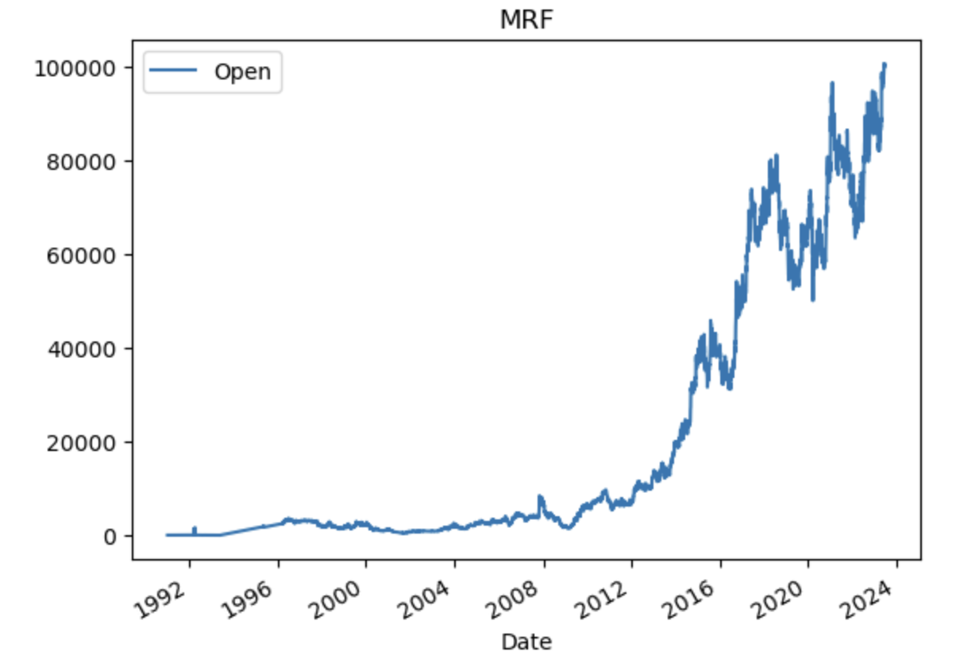
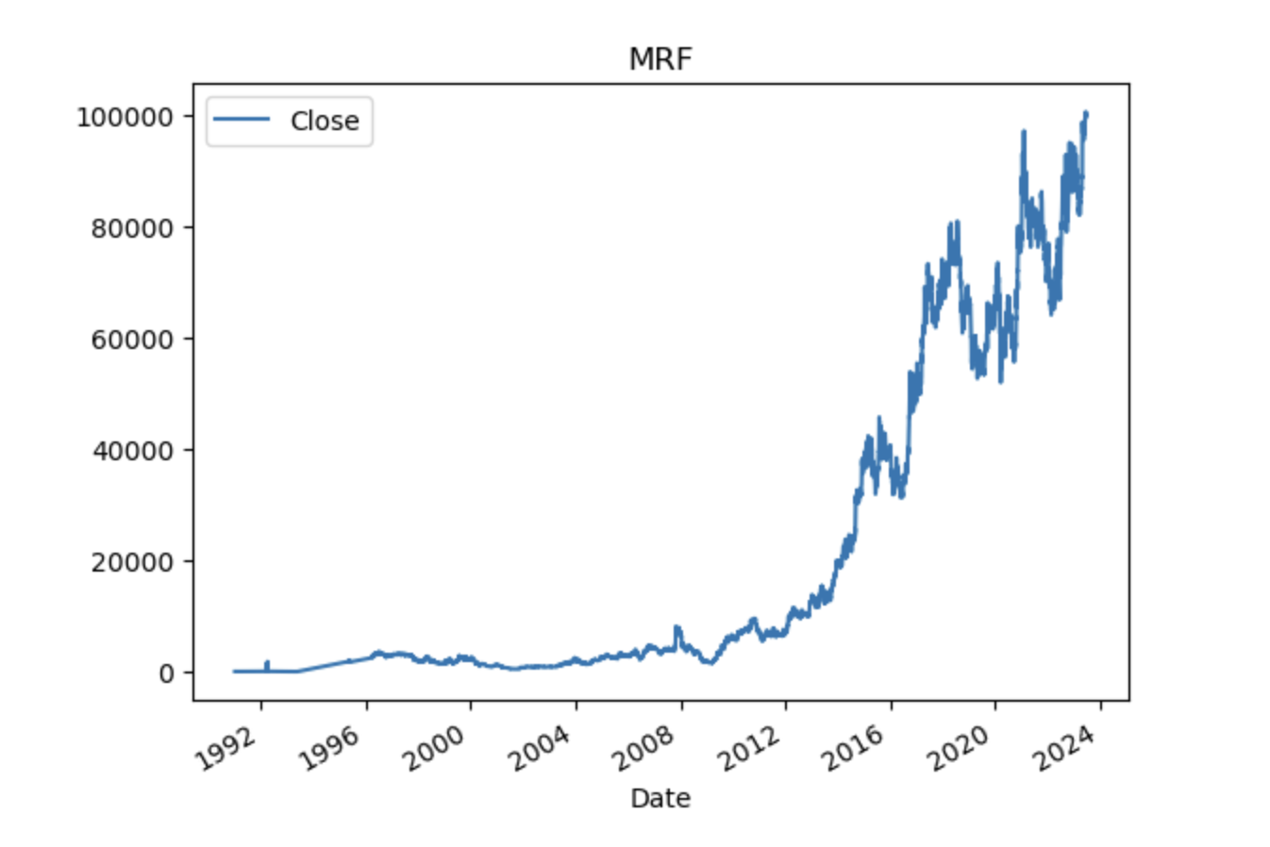
Rise to new Heights
Steady Climb over the years, reflecting a continuous growth pattern.
Surpassing Milestones and reaching new heights indicating the company's ability to achieve significant market value and attract investor attention.
Growth Potential making it an attractive investment opportunity.
Investor Confidence highlighting the trust and confidence investors have in MRF's performance and future prospects.

Slide 4
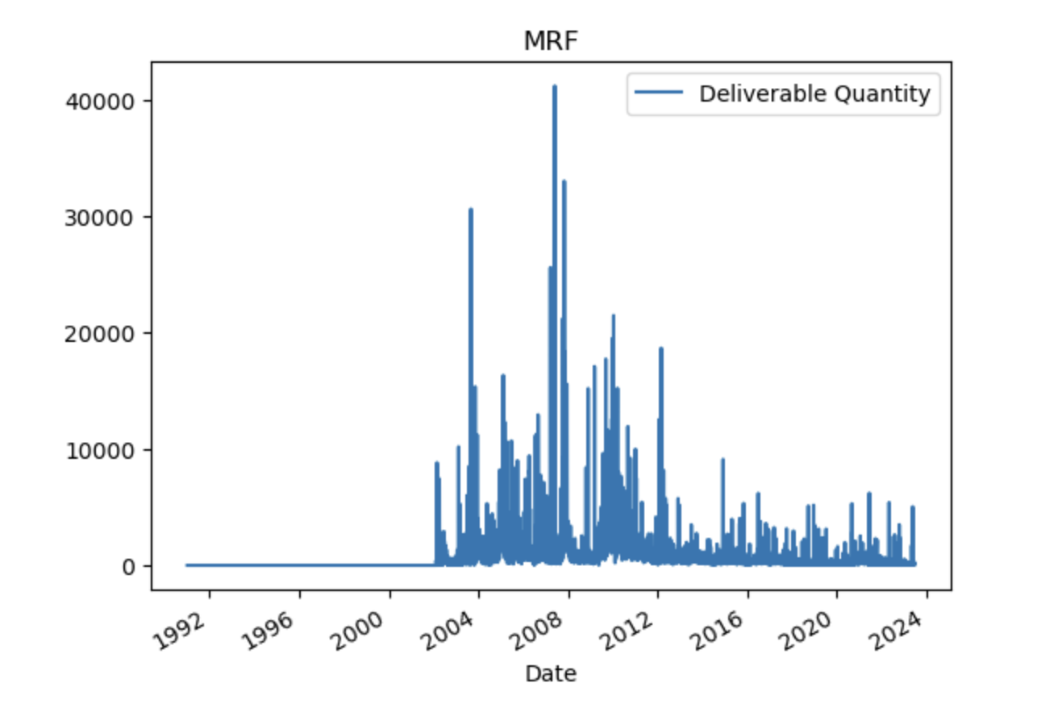
Liquidity and Market Activity
Deliverable Quantity Fluctuations: Between 2003 and 2012, the deliverable quantity of MRF shares experienced notable fluctuations, indicating varying levels of trading activity during this period indicating active participation from investors.
Highest Recorded Deliverable Quantity: In 2008, MRF shares witnessed the highest recorded deliverable quantity, reaching approximately 40,000 shares. This significant figure reflects a substantial trading interest and liquidity in MRF shares during that specific time.
Changing Market Dynamics: From 2017 to 2023, MRF's deliverable quantity remained below 10,000 shares, indicating a shift in market dynamics with lower trading activity. Possible influences include investor sentiment, industry developments, stock price changes, and broader market conditions.

Slide 5
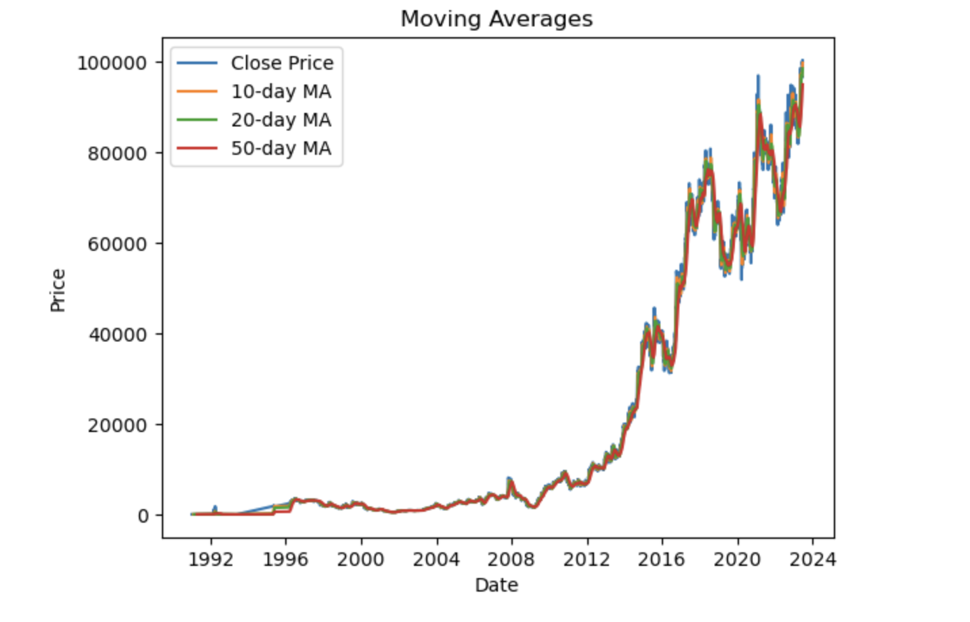
Unveiling Trends and Filtering Market Noise
Consistent Growth from 2012 to 2023 as evidenced by the moving averages (MA).
Steady and gradual increase in the stock's value over time.
Low Volatility suggesting a stable and predictable price movement.
long-term value appreciation.
A reliable investment option.

Slide 6
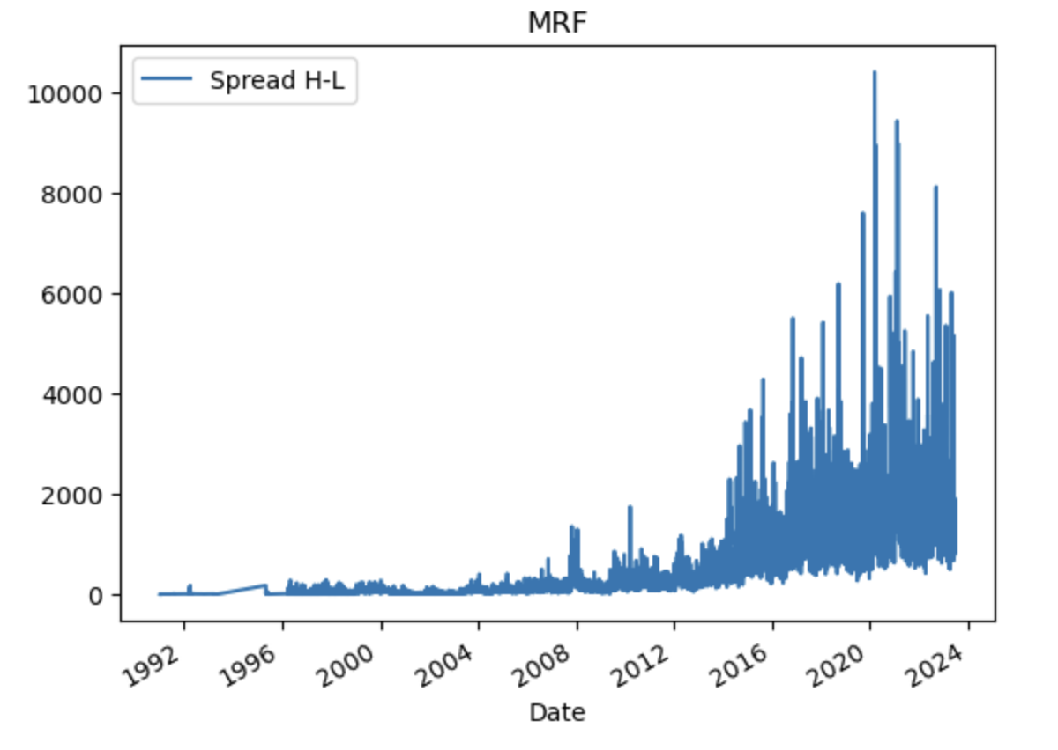
Decoding Spread H-L for In-Depth Market Analysis
1991-2007: Stable Period: Minimal Spread H-L, indicating limited price fluctuations.
2008-2015: Increased Volatility: Wider Spread H-L range due to heightened market uncertainty.
2015-2020: Continuous Expansion: Price fluctuations expanded with higher Spread H-L.
Peak Volatility in 2020: Spread H-L reached approximately 10000, indicating exceptional price range and volatility.
2020: Highest Volatility: Recorded peak volatility with the highest Spread H-L level.

Slide 7
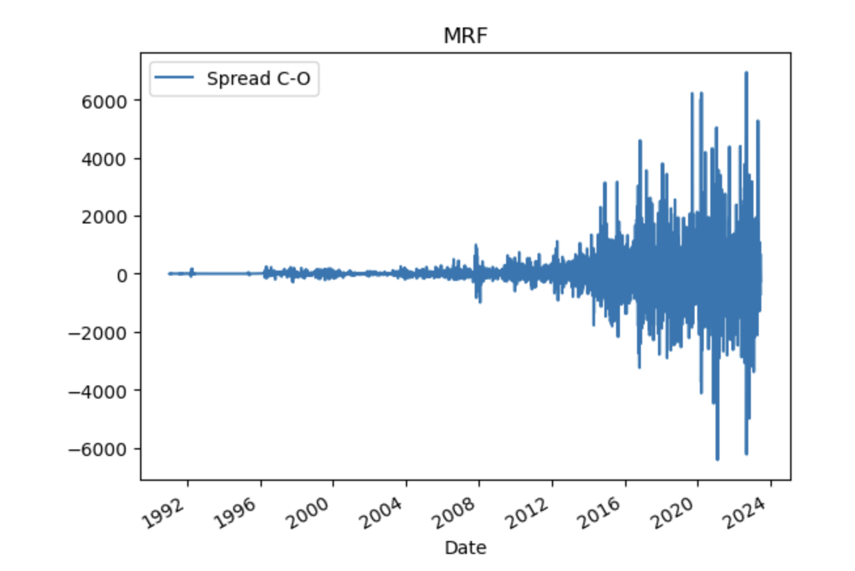
Navigating Intraday Price Movements
Significant Positive Change in 2023: In 2023, the Spread C-O experienced a notable increase, reaching approximately 7000. This indicates a substantial positive change in price from the market open to close during that specific period.
Largest Negative Change in 2021: Conversely, the year 2021 witnessed the most significant negative change in the Spread C-O. The price movement from the market open to close showed a substantial decrease, reflecting a notable negative change in that particular year.
Risk Management: Leads to implement risk mitigation strategies, such as adjusting position sizes, setting stop-loss ordersdue to intraday volatility, or diversifying their long term portfolios to manage potential losses during periods of heightened volatility.

